Slide 1
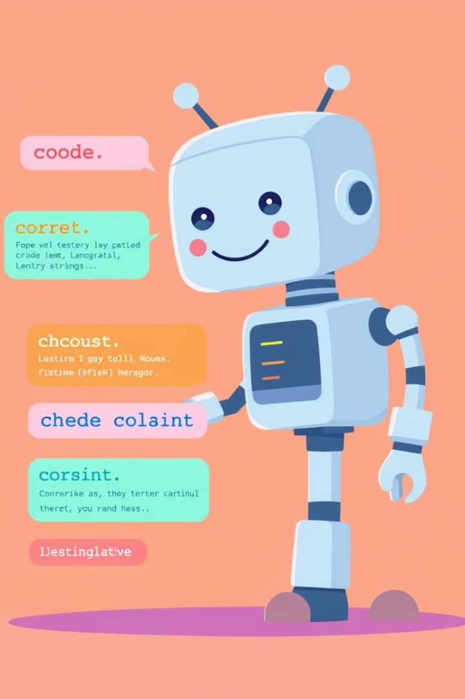
Code Translation Between Two Programming Languages Using LLMs
Course Project Part 1: Literature Review
CCSW-325 Software Construction

Slide 2
Unraveling the Potential of Large Language Models in Code Translation: How Far Are We?
Idea
Method
This study investigates the effectiveness of large language models (LLMs) in translating code across different programming languages. It highlights the limitations of current models due to their lack of extensive training on parallel multilingual code.
Developed a novel benchmark, PolyHumanEval, by extending HumanEval to 14 programming languages.
Conducted over 110,000 translations using various LLMs.
Proposed two improvement strategies:
Intermediary translation using Go as a pivot language.
Self-training by fine-tuning LLMs on self-generated parallel data.

Slide 3
Unraveling the Potential of Large Language Models in Code Translation: How Far Are We?
Datasets
Results
LLMs perform well in translating other languages to Python but struggle in the reverse direction.
CodeLlama-13B achieved the highest CA score (76.55% for Python translations).
The proposed intermediary translation and self-training approaches improved translation accuracy by 11.7% on Python-to-other translations.
Go was found to be an effective intermediary language.
PolyHumanEval benchmark (2296 solutions across 14 languages for 164 problems).
Evaluation Metrics
Computational Accuracy (CA): Measures whether translated code produces the same output as the source code (pass@1).

Slide 4
Unraveling the Potential of Large Language Models in Code Translation: How Far Are We?
Reflection
Contributions: Introduced a comprehensive multilingual code translation benchmark and novel enhancement techniques.
Limitations: Limited performance improvements on certain languages; intermediary translation is not universally optimal.
Future Research: Investigating better intermediary languages and improving the quality of self-generated parallel data

Slide 5
Towards Translating Real-World Code with LLMs: A Study of Translating to Rust
Idea
Method
This paper assesses the ability of state-of-the-art LLMs (GPT-4, Claude 3, Claude 2.1, Gemini Pro, and Mixtral) to translate real-world code to Rust, a modern language known for safety and performance.
Developed FLOURINE, an end-to-end code translation tool.
FLOURINE applies differential fuzzing to ensure translated Rust code is I/O equivalent to the original source program.
Investigated whether LLMs could correct translation errors when provided with feedback (e.g., counterexamples).

Slide 6
Towards Translating Real-World Code with LLMs: A Study of Translating to Rust
Datasets
Evaluation Metrics
Extracted benchmarks from seven real-world open-source projects written in C and Go.
Code samples include complex real-world structures like global variables and user-defined data types.
Translation Success Rate: Whether the translated Rust code compiles and passes I/O equivalence tests.

Slide 7
Towards Translating Real-World Code with LLMs: A Study of Translating to Rust
Results
Reflection
The best-performing LLM achieved a 47% successful translation rate.
Larger programs had lower success rates.
Feedback strategies involving counterexamples were less effective than repeating the original prompt
Contributions: First study focusing on real-world code translation to Rust; introduced a novel differential fuzzing approach.
Limitations: Low translation success rates; existing LLMs struggle with complex real-world code.
Future Research: Exploring better feedback mechanisms and improving translation accuracy through fine-tuning

Slide 8
TRANSAGENT: An LLM-Based Multi-Agent System for Code Translation
Idea
Method
Utilizes four specialized LLM-based agents:
Initial Code Translator: Generates an initial translation.
Syntax Error Fixer: Fixes syntax issues iteratively based on compiler error messages.
Code Aligner: Maps code blocks between source and target programs using control-flow analysis and LLMs.
Semantic Error Fixer: Identifies and corrects functional errors by analyzing runtime behaviors.
Uses a block-level mapping strategy for more accurate error localization.
Introduces a new benchmark to prevent data leakage issues from previous datasets.
This paper proposes TRANSAGENT, a multi-agent system that enhances LLM-based code translation by fixing syntax and semantic errors. The approach aims to improve translation correctness by dynamically localizing and addressing errors in the translated code.

Slide 9
TRANSAGENT: An LLM-Based Multi-Agent System for Code Translation
Datasets
Evaluation Metrics
Translation Effectiveness: Measures correctness compared to state-of-the-art techniques like UniTrans.
Mapping Accuracy: Evaluates Code Aligner’s ability to correctly match code blocks.
Cost Efficiency: Assesses computational expense.
Generalization: Tests performance across multiple LLMs.
Constructed from recent programming tasks to mitigate data leakage from older datasets.

Slide 10
TRANSAGENT: An LLM-Based Multi-Agent System for Code Translation
Results
Reflection
Contributions: Introduces a modular, multi-agent approach that improves accuracy and efficiency in code translation.
Limitations:
Some syntax errors remain difficult for LLMs to fix, even with enhanced strategies.
The approach relies on existing LLMs, which still have fundamental translation weaknesses.
Future Research: Further refining error localization and exploring better LLM-based reasoning techniques
Outperformed UniTrans and TransCoder in translation effectiveness.
Code Aligner improved mapping accuracy by 39.6% compared to previous methods.
More cost-efficient than baseline approaches.
Demonstrated generalization across different LLMs with consistent performance

Slide 11
Exploring and Unleashing the Power of Large Language Models in Automated Code Translation
Idea
Method
Conducted an empirical study on five LLMs (GPT-3.5, LLaMA-7B, LLaMA-13B, CodeGen) and three state-of-the-art learning-based transpilers.
Identified common translation failures (e.g., logic errors, API misusage, missing I/O type specifications).
Proposed UniTrans, a three-phase framework:
Test Case Generation: LLMs generate test inputs and expected outputs for verification.
Translation Augmentation: Uses test cases to improve translation accuracy.
Translation Repair: Iteratively fixes incorrect translations using test case feedback.
This paper evaluates how well LLMs perform in automated code translation compared to traditional transpilers and introduces UniTrans, a framework designed to improve LLM-based translation accuracy.

Slide 12
Exploring and Unleashing the Power of Large Language Models in Automated Code Translation
Datasets
Evaluation Metrics
Computational Accuracy (CA): Measures correctness of translated programs.
Exact Match Accuracy (EM Acc): Assesses whether translations exactly match expected results.
Cleaned and improved the widely used TransCoder dataset (Python, Java, C++).
Evaluated on six different translation tasks.

Slide 13
Exploring and Unleashing the Power of Large Language Models in Automated Code Translation
Results
Reflection
Contributions:
First large-scale empirical study comparing LLMs to transpilers.
Introduced UniTrans, which boosts translation quality using self-generated test cases.
Limitations:
Translation accuracy is still below 50% in some cases.
LLMs struggle with complex program logic and API differences.
Future Research: Expanding test case strategies and improving reasoning capabilities in LLMs​
UniTrans improved LLM-based translation:
GPT-3.5: +4.02% CA, +13.28% EM Acc
LLaMA-13B: +19.20% CA, +36.42% EM Acc
LLaMA-7B: +28.58% CA, +71.22% EM Acc
Test cases significantly enhanced translation performance.

Slide 14
Lost in Translation: A Study of Bugs Introduced by Large Language Models while Translating Code
Idea
Method
Conducted a large-scale empirical study analyzing translation bugs in various LLMs.
Categorized bugs into compilation errors, runtime errors, functional errors, and non-terminating execution.
Evaluated whether prompt engineering techniques could mitigate errors.
This paper examines the types of errors LLMs introduce during code translation, comparing LLM-based approaches to traditional methods.

Slide 15
TRANSAGENT: An LLM-Based Multi-Agent System for Code Translation
Datasets
Evaluation Metrics
Translation Success Rate: Percentage of correctly translated code.
Error Analysis: Classification of translation failures into distinct bug categories.
Benchmarks from previous studies (CodeNet, Avatar, EvalPlus).
Two real-world projects: Apache Commons CLI (Java) and Click (Python)

Slide 16
TRANSAGENT: An LLM-Based Multi-Agent System for Code Translation
Results
Reflection
Contributions: Provides a taxonomy of translation errors and insights into the weaknesses of LLMs in real-world scenarios.
Limitations: LLMs fail at complex dependencies, method overloading, and language-specific nuances.
Future Research: Enhancing LLMs with better fine-tuning datasets and refining error correction techniques​.
LLMs struggle with API mismatches, incorrect data types, and missing imports.
Translating to Go had more compilation errors due to its strict syntax.
Real-world projects were significantly harder to translate compared to crafted benchmarks.
The best-performing LLM had a 47.3% success rate on all datasets

Slide 17
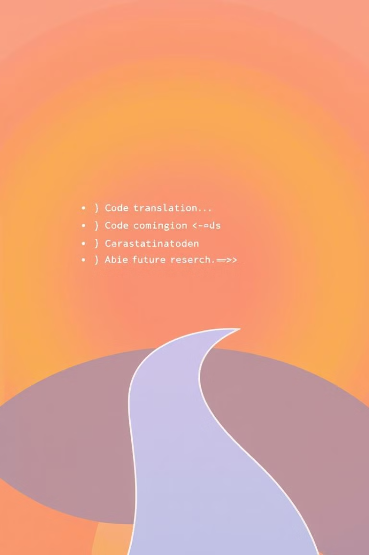
Thank you.

